Slide 1
Microcomputer Principles
&
Computer Interface
Lu Yin
luyin@nwpu.edu.cn

Slide 2
Chapter 14 Interrupts in x86 PC
Contains
  Describes how does the X86 PC handle a interrupt request with the help of Interupt Vector and Interrupt Service Routine;
  Discuses the relationship between Interrup Request, Interrupt Service Routine, Interrupt Vector, Interrupt Vector Table and Interrupt Number;
  Discuses the differences between interrupts and sub routine CALLing;
  Discuses the differences between hardware and software interrupts;
  Analyzes the structure of Interrupt Service Routine, and how to register it to the operating system;
  Extend interrupts of X86 PC with Programmable Interrupt Controller 8259

Slide 3
Section 14.1 8086 Interrupts
Concepts of Interrupt:
  Interrupt: An interrupt is an external event witch informs the CPU that a device needs its service. The signal witch causes an interrupt is called an Interrupt Request (IRQ).
  Interrupt Service Routine (ISR): ISR is a piece of executable program. It is invoked by the processor automatically when an IRQ comes. Most ISR runs in a kernel process instead of current user process. When it is finished, the processor will return back to the current user process.
  Interrupt Vector: The entrance address (the beginning address) of the ISR is generally called as Interrupt Vector. It can be regarded as a function pointer in C/C++ language.
  In some type of DSP processors, Interrupt Vector is written into a Interrupt Vector Register, which in bound with a Interrupt Source during the initialization process;

Slide 4
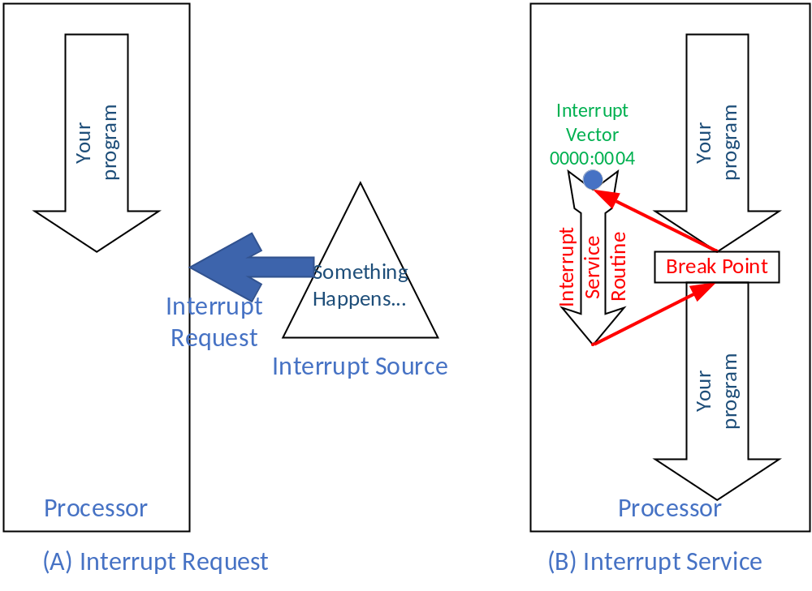

Slide 5
Section 14.1 8086 Interrupts
General steps to handle a interrupt request :
  1) Push FR , then clear IF TF to disable interrupt;
  2) Push IP and CS onto the stack;
  3) Identify the interrupt source; Locate the interrupt vector in the interrupt vector table;
  4) load the interrupt vector into IP and CS;
  5) Run the ISR, till IRET is met
  6) Pop out CS, IP and FR
  7) ISR returns, and continue the previous task

Slide 6
Section 14.1 8086 Interrupts
Concepts of Interrupt:
  However, in the X86 family processor, all the Interrupt Vectors is organized into a block of memory. Thus a Interrupt Vector Table is constructed.
  In a X86 PC, the first 1024 bytes within the memory space is allocated for the interrupt vector table. Each vector contains 4 bytes, 2 bytes for CS, and 2 bytes for IP. The starting address of an interrupt vector in the vector table is always four times the value of the interrupt number.
  Interrupt vectors are saved in the interrupt vector table one after another. The INDEX of a interrupt vector in the interrupt vector table is called as Interrupt Number.

Slide 7
Section 14.1 8086 Interrupts
Example 14-1
Find the physical and logical addresses in the interrupt vector table associated with:
  (a) INT 12H (b) INT 8
Solution:
  (a) 12H x 4 = 48H so
    PA = 00048H ~ 0004BH; LA = 0000:0048H
  (b) 8 x 4 = 32 = 20H
    PA = 00020 ~ 00023H; LA = 0000:0020H

Slide 8
Section 14.1 8086 Interrupts
Concepts of Interrupt:
  Inter make use of Interrupt Number to locate the interrupt vector within the interrupt vector table. That is to say, it is the Interrupt Number but not the Interrupt Vector that is bound with the Interrupt Source in the X86 processor family.
  Each time when a interrupt source sends a interrupt request to the processor, an interrupt number is provided all at the same time. And the processor will find the interrupt vector for that source based on the interrupt number provided.

Slide 9
Section 14.1 8086 Interrupts
Steps to handle a interrupt request (in x86 PC):
  1) PUSH FR, then clear IF and TF in FR
  2) PUSH IP and CS onto the stack
  3) Identify the interrupt source by fetching the interrupt number the PIC sends, or by load the operand of INT instruction
  4) Locate the interrupt vector by SHL the interrupt number by 2
  5) load the interrupt vector up to CS and IP. Note that in each slot for the interrupt vector, the IP is in the lower parts.
  6) Run the ISR, till IRET is met
  7) Pop up CS, IP and FR
  8) ISR returns, and continue the previous task

Slide 10
Section 14.1 8086 Interrupts
Difference between INT and CALL
  As in interrupt handling and far CALL, both of them needs to reset CS and IP, what is the difference?
 | CALL FAR | Interrupt Handling
1 | May goes to any address with in 1M bytes of x86 | Must goes to the address pointed by it’s Interrupt Vector
2 | Invoked by the programmer Do thing on behalf of the programmer | Triggered by an externally interrupt source. Do thing the handle the interrupt requests
3 | Can not be masked | Most of them can be masked. For example, in x86 PC, the FR.bit9 (IF) =0 may disable interrupt response except NMI
4 | PUSH CS and IP | PUSH CS and IP together with FR
5 | Use RET to return And pop IP CS | Use IRET to return And pop IP CS and FR
Notes:
0, CALL ,when to happen , where to back
Interrupt: do not know when happen , break point differences each time

Slide 11
Section 14.1 8086 Interrupts
Categories of interrupts in x86
  Hardware interrupt
    maskable interrupt: interrupt triggered by external hardware request, and can be masked by setting FR.IF=0. Maskable interrupt request is inputted from the INTR PIN.
    Nonmaskable interrupt: Also a type of hardware interrupt. However it is inputted from the NMI PIN and can not be masked.
  Software interrupt
    Interrupt trigger by software instructions INT xx. INT is a two bytes instruction. The former byte is the op code, and the second byte is the interrupt number. Software interrupt can not be masked by FR.IF bit
  In x86 PC
    INT 00 is divide error, divide by zero
    INT 02 is predefined by Intel for NMI.
    INT 01, 03 and 04 is reserved for single step, breakpoint and overflow
    INT 05 ~ INT 31 is reserved for PC expansion devices
    INT 032 ~ INT 0FF can be used by user interrupts, both hardware or software

Slide 12
Section 14.1 8086 Interrupts
Interrupts and the flag register
  FR.IF (Interrupt enable flag, bit9): clean IF=0 will ban interrupt request from INTR pin. IF can be setupped or cleaned by STI and CLI.
  FR.TF (Tap of single step flag, bit8): Set TF=1 to enable INT 01 (the single step executing interrupt). Only can be set or canceled via PUSHF and POPF process.

Slide 13
Section 14.1 8086 Interrupts
Functions associated with INT 00 to INT 04 (the predefined interrupts)
  INT 00H: in the category of conditional or exception interrupts. They are invoked by the microprocessor whenever an unable-handled exception happens. INT 00 is for divided by zero exception only.
  INT 01H: If IF.TF is set, INT 01 is automatically invoked by the processor after the execution of each instruction. ISR for INT 01 dumps the register contents to the screen
  INT 02H: ISR for NMI, including:
    Read /Write PCK (parity check) : by checking 8255.PortC.PC7
    IOCHK (input/output channel check) : by checking 8255.PortC.PC6
    NPIRQ (numerical processor interrupt request) : if it is not the two above

Slide 14
Section 14.1 8086 Interrupts
Functions associated with INT 00 to INT 04 (the predefined interrupts)
  INT 03H: Breakpoint. If a breakpoint is set, then a INT 03H instruction is inserted.
  INT 04H: Signed number overflow. Invoked by typical instruction INTO. Generally, INTO is put after a numerical arithmetic of signed numbers. In the execution of INTO, the CPU checks the FR.OF, and invoke INT 04 if OF=1; or do nothing if OF = 0.

Slide 15
Section 14.2
x86 PC and Interrupt Assignment
Three categories of interrupt number:
  PC peripheral hardware (BIOS)
  Microsoft operating system
  Available for programmers of software applications
(see Table 14-2 @ p375):

Slide 16
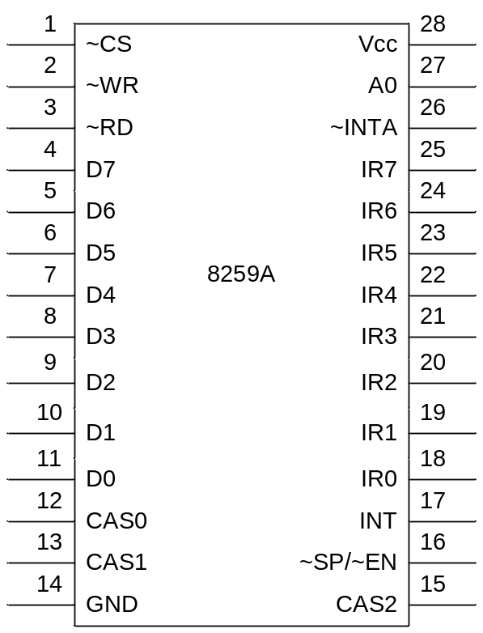
Section 14.3
8259 Programmable Interrupt Controller
X86 PC uses 8259A PIC to extend INTR
  CAS0~CAS2: PIN used for cascading several PIC in a master/slave configuration. For master PIC, they are used to select slave PIC by outputting slave PIC index; for a slave PIC, they are used to input the slave PIC index so that to know whether it is selected by the master.
  ~SP/~EN: Slave programming/enable. In buffered mode, it is output to activate transceiver; In non-buffered, it is input to indicate it is master (~sp=1)or slave.
  INT and INTA: INT is for interrupt request output (connect to CPU.INTR), and INTA is for interrupt response answer (connect to CPU.INTA)
  IR0~IR7: Interrupt request input.

Slide 17
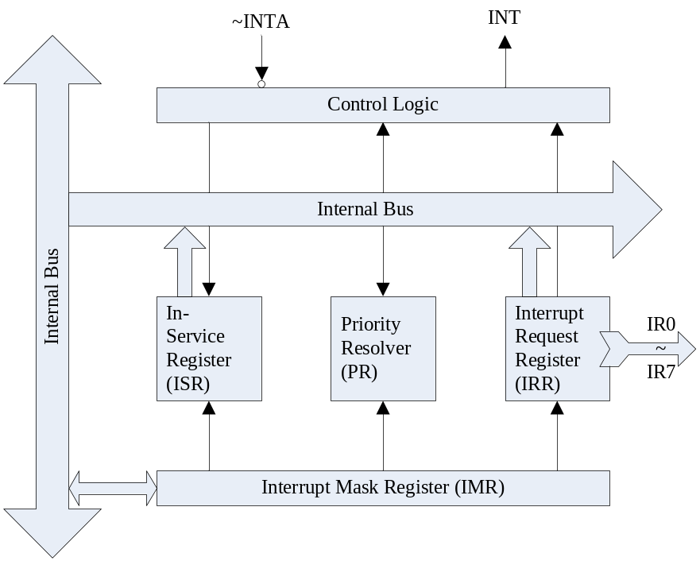
Section 14.3
8259 Programmable Interrupt Controller
Unit functions
  IRR: latch the status of IR0~IR7
  IMR: mask off IRx (can be programmed)
  PR: masks off low level IRQs, and lets preemptive for high level IRQs
  ISR: indicate which IRQ is being serviced.

Slide 18
Section 14.3
8259 Programmable Interrupt Controller
How does it works:
  Peripheral device asking for Interrupt service (IRx high jump)
  The request is latched into IRR
  If IRx is not masked in IMR, then IRx is send to PR
  ISR is fetched and compared with IRx. If the priority of IRx is higher than the IRQ being serviced, INT is set to high to inform the CPU a new interrupt source is requesting service
  If CPU.FR.IF = 0, then when the current instruction finish executing, tow rounds of ~INTA is dispatched to PIC
  When the PIC receives the 1st ~INTA pulse, IRR is disabled to prevent further IRQs. Then the IRx bit in the ISR is set to indicate that IRx will be serviced. This operation cause IRx in IRR reset.
  When the PIC receives the 2nd ~INTA pulse, it sends out the interrupt number to the DB, and enable IRR for further IRQs.
  At the end of the 2nd ~INTA cycle, the CPU fetches the Interrupt Number from DB, calculates the addr of the Interrupt Vector, and goes to ISR.
  When the ISR goes to IRET instruction, a EOI command is send to the PIC by the CPU, and the instruction causes ISRegister in PIC to be restored.

Slide 19
Section 14.3
8259 Programmable Interrupt Controller
combination of the PIN
A0 | ~CS | ~RD | ~WR | D4 | D3 | RD/WR will do:
0 | 0 | 1 | 0 | 0 | 0 | Write OCW2
0 | 0 | 1 | 0 | 0 | 1 | Write OCW3
0 | 0 | 1 | 0 | 1 | X | Write ICW1
1 | 0 | 1 | 0 | X | X | Write ICW2, ICW3, ICW4, OCW1
0 | 0 | 0 | 1 |  |  | Read interrupt type, IRR, ISR
1 | 0 | 0 | 1 |  |  | Read Interrupt mask reg (IMR)
X | X | 1 | 1 | X | X | Illegal or no operation defined
x | 1 | X | X | X | x | Illegal or no operation defined

Slide 20
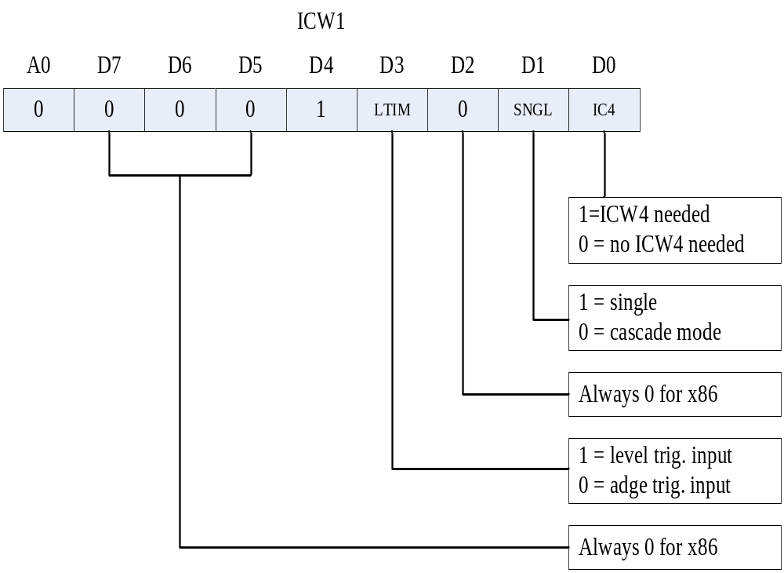
Section 14.3
8259 Programmable Interrupt Controller
ICW1 (initialization command word1):
  The programming of 8159A begins from write ICW1 I(A0=0). And it will reset the PIC
  ICW1 defines the module of the interrupt unit of the PC.
    SNGL(D1) = 0 means at least 2 piece PIC is cascaded.
    LTIM(D3) = 0 means edge triggered.
    IC4 (D0) defines how to finish a interrupt response transaction.

Slide 21
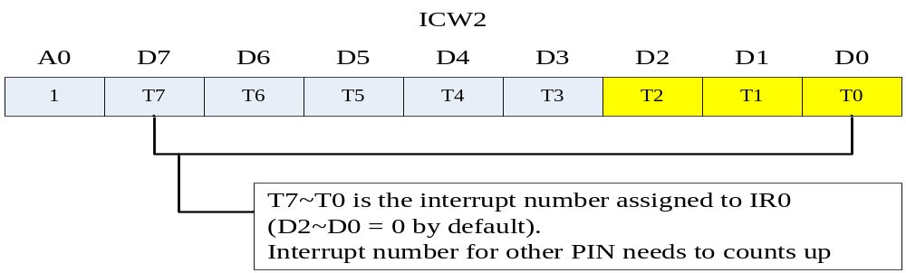
Section 14.3
8259 Programmable Interrupt Controller
ICW2
  Programming of ICW2 follows ICW1
  ICW2 defines the interrupt number assigned to this PIC
    Interrupt number of IR0 ~ IR7 is continuous
    D7~D3 defines the higher bits of the interrput number
    D2~D0 is 0 by default
    When interrupt number is send to DB, D2~D0 selects IR7~IR0

Slide 22
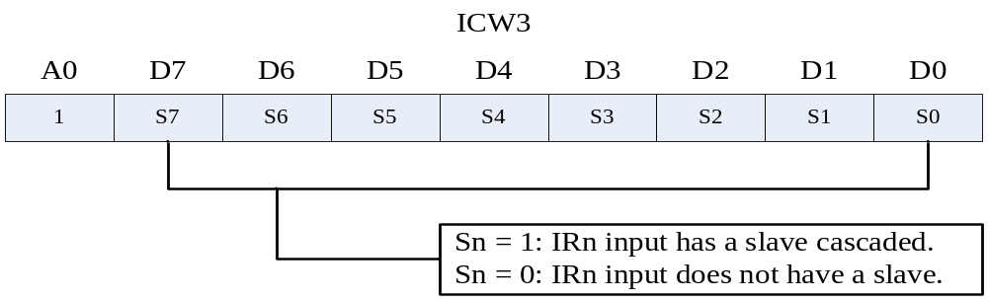
Section 14.3
8259 Programmable Interrupt Controller
ICW3 (master mode)
  If ICW1.bit1=0 (cascaded), then ICW3 is needed
  Programming of ICW3 follows ICW2
  Each bit in ICW3 (Sn) shows whether there is PIC extended from IRn
  Both master and slave should be programmed

Slide 23
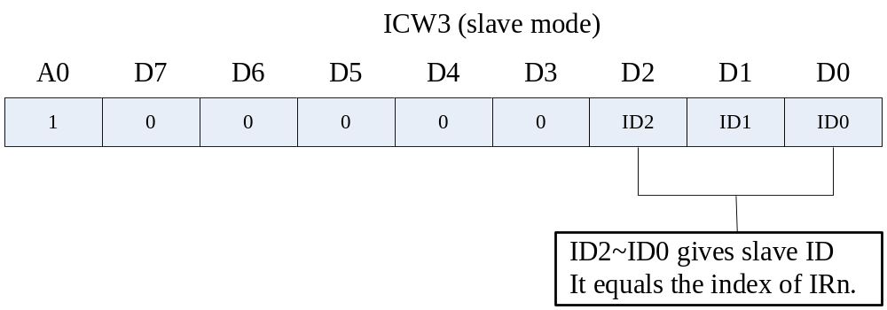
Section 14.3
8259 Programmable Interrupt Controller
ICW3 (slave mode)
  Both master and slave should be programmed
  D2~D0 in ICW3 slave mode tells the slave PIC from which PIN it extends

Slide 24
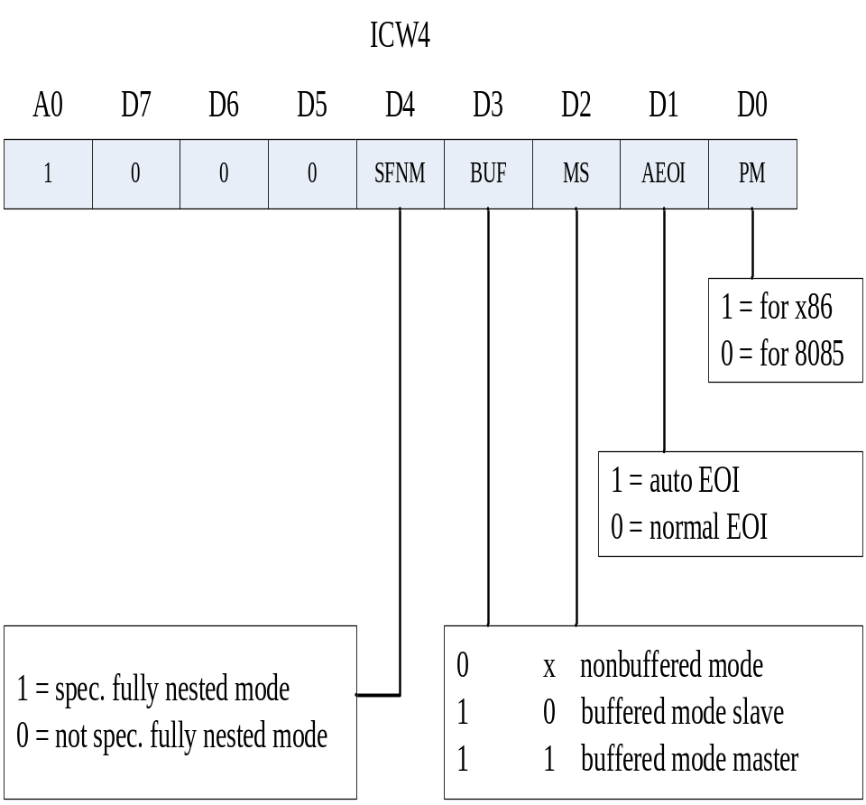
Section 14.3
8259 Programmable Interrupt Controller
ICW4
  ICW4 defines the way interrupt is handled
    D0 indicates the processor mode
    D1 indicates how does the ISR return
      0 = last three instructions must include EOI cmd followed by IRET (using OCW)
      1 = ISR returns automatically
    D2 and D3 indicates whether the system DB is buffered
    D4 (only useful in master mode)
      1 = Spec. fully nested mode
      0 = none spec. fully nested mode

Slide 25
Section 14.3
8259 Programmable Interrupt Controller
Example 14-8
  A PIC 8259 is used with a 8088CPU, single, level triggering IRs, and IR0 is assigned “INT 50H”. The 8259 is in slave buffered mode with normal EOI.
    Find the ICWs for the PIC
    Program to initialize the PIC. The ports assigned to the PIC is 26H and 27H;
    Find the address associated with IR0, IR1 and IR2 in the interrupt vector table.

Slide 26
Example 14-8 solution
  A PIC 8259 is used with a 8088CPU, single, level triggering IRs, and IR0 is assigned “INT 50H”. The 8259 is in slave buffered mode with normal EOI.
    The ICW1 = 1BH
      D0 = 1 : ICW4 needed
      D1 = 1 : single
      D2 = 0 : always 0 for x86 CPU
      D3 = 1 : level triggering
      D4 = 1 : required by the ICW1 itself
      D5=D6=D7=0: always 0 for x86 CPU

Slide 27
Example 14-8 solution
  A PIC 8259 is used with a 8088CPU, single, level triggering IRs, and IR0 is assigned “INT 50H”. The 8259 is in slave buffered mode with normal EOI.
    The ICW2 = 50H
      ICW2 setup the interrupt number for all the IRs;
      And the value write into ICW2 always equals to the interrupt number assigned to IR0;

Slide 28
Example 14-8 solution
  A PIC 8259 is used with a 8088CPU, single, level triggering IRs, and IR0 is assigned “INT 50H”. The 8259 is in slave buffered mode with normal EOI.
    The ICW3 not needed for there is no cascaded PICs
    The ICW4 = 09H
      D0 = 1 : 8088 CPU
      D1 = 0 : normal EOI, need OCW2 to quit service
      D2 = 0;D3=1: slave buffered mode for single piece PIC
      D4 = 0 : not nested
      D5=D6=D7=0: always 0 for x86 CPU

Slide 29
Example 14-8 solution
  The initialization program:
      MOV AL, 1BH ;ICW1
      OUT 26H, AL
      MOV AL, 50H ;ICW2
      OUT 27H, AL
      MOV AL, 09H ;ICW4
      OUT 27H, AL

Slide 30
Example 14-8 solution
  Find the address associated with IR0, IR1 and IR2 in the interrupt vector table.
      As INT 50H is assigned to IR0, interrupt number for IR1 and IR2 should be 51H, 52H;
      Vector addr of IP = interrupt number x 4;
      Vector addr of IP saves in the low address within vec-table;
IRQ pin | INT number | Vector addr DS | Vector addr IP | Vector addr CS
IR0 | 50H | 0 | 0140H | 0142H
IR1 | 51H | 0 | 0144H | 0146H
IR2 | 52H | 0 | 0148H | 014AH

Slide 31
Example 14-8 solution
  Register ISR (1):
  ( Write in vector of ISR into vector table directly )
      PUSH DS ;save current DS value
      MOV AX, 0 ;set DS to the segment address of
      MOV DS, AX ;DOS interrupt vector table
      MOV BX, OFFSET myISR ;load IP address value of ISR
      MOV SI, SEG myISR ;load CS address value of ISR
      MOV [0140H], BX ;write IP into 0140H for INT 50H
      MOV [0142H], SI ;write CS into 0142H
      POP DS ;restore current DS value

Slide 32
Example 14-8 solution
  Register ISR (2):
  ( Write in by using DOS software interrupt service)
  DOS INT 21H function 25H saves interrupt vector. It requires that AL to hold interrupt number, DX to hold IP of interrupt service routine, DS to hold CS of ISR.
      PUSH DS ;save current DS value
      MOV AH，25H ;DOS INT 21H function 25H
      MOV AL, 50H ;prepare interrupt number
      MOV DX, OFFSET myISR ;prepare IP of ISR into DX
      MOV BX, SEG myISR ;load CS of ISR
      MOV DS, BX ;prepare CS of ISR into DS
      INT 21H ;invoke the software interrupt
      POP DS ;restore current DS value

Slide 33
Example 14-8 solution
  Program the Interrupt Service Routine:
  The PIC 8259 is set to be working in normal EOI mode, it requires the ISR to send a EOI command word to it before executing the IRET instruction. A normal EOI command word is a OCW2 word with its D7=0, D6=0, and D5=1.
  For example EOI command word for IR0 = 001 00 000B =20H
      myISR PROC FAR ; ISR for IR0
      STI
      ; do something
      sendEOI: MOV AL, 20H
      OUT 26H, AL
      IRET
      myISR ENDP

Slide 34
Section 14.3
8259 Programmable Interrupt Controller
Masking and prioritization of IR0~IR7 Interrupts
  When all the ICW words have been written into the PIC, the PIC is ready to handle interrupt request from peripheral hardware.
  Enable / Disable interrupt request and change priority of IR PINs should be enabled on run time
OCW (operation command word)
  OCW is defined to manipulate the operating mode of the PIC, including change interrupt priority of IRx pins, mask or unmask interrupt sources

Slide 35
Section 14.3
8259 Programmable Interrupt Controller
OCW1
  OCW1 is used to mask any of IR0~IR7. It is written into register IMR (interrupt mask reg.)
  By masking high priority IR pins, the real priority of all the pins can be changed in run time.
  OCW1 can be read out to fetch the enable status of all the IRQ pins.
    Eg. If I/O port of 8259A is 27H, use:
      MOV AL, 00
      IN AL, 27H (A0=1, ~RD=0, port=27H)

Slide 36
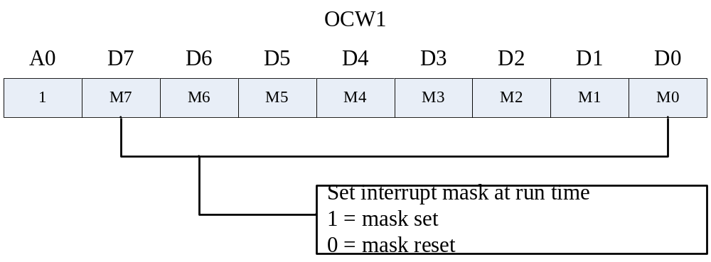
OCW1
OCW1

Slide 37
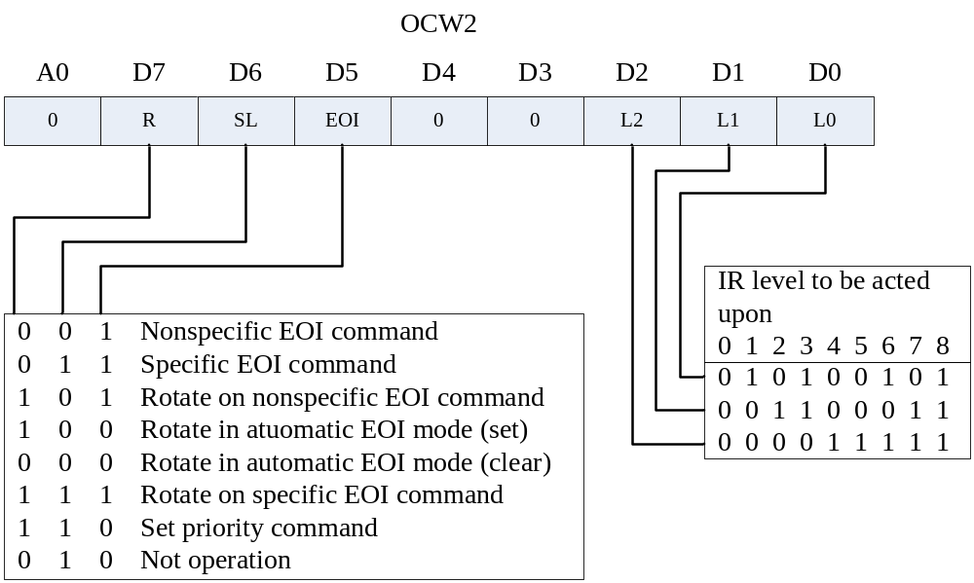
Section 14.3
8259 Programmable Interrupt Controller
OCW2 is used to assign a specific priority to IRs (shift the priority shifting method)(D4D3 must be 0)

Slide 38
Section 14.3
8259 Programmable Interrupt Controller
OCW2 is used to assign a specific priority to IRs
Interrupt priority scheduling scheme:
  Fully nested mode : IR0~IR7 priority decrease. And the pin with the highest priority can be defined by L2L1L0. High priority request may preemptive the service of the low one.
  Automatic rotation mode: The interrupt source just served will be scheduled to the lowest priority
    Eg: IR1 and IR4 is requesting interrupt service
      Now: ISR = IR0 IR1 IR2 IR3 IR4 IR5 IR6 IR7
      After: ISR = IR2 IR3 IR4 IR5 IR6 IR7 IR0 IR1
Bits in OCW2 in relevant with priority scheduling:
  D7 (R) in OCW2 indicates whether the priority should be rotated (normal rotate)
  D6 (SL) in OCW2 indicates the one being rotated is the one just served, or the one defined by L2~L0 (spec. rotate)

Slide 39
Section 14.3
8259 Programmable Interrupt Controller
OCW2 is used to assign a specific priority to IRs
When D5 (EOI) in OCW2 is set to be 1, it is a “end of interrupt” command
  The EOI command clears the bit in ISR, to inform PIC 8259 that a interrupt service is ended.
  The last three instructions of any interrupt service routine must be issuing the EOI command. Otherwise, interrupt requests that is lower than the one being serviced (including the one being serviced) will be blocked.
  Example: Issuing EOI command
    INT_SERV PROC FAR
    … …
    MOV AL, 20H ;The EOI byte for OCW2
    OUT 26H, AL
    IRET

Slide 40
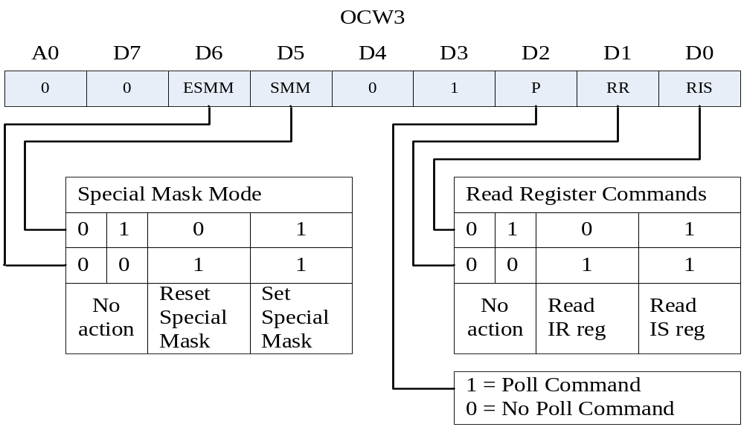
Section 14.3
8259 Programmable Interrupt Controller
OCW3
  OCW3 is used to read IRR and ISR

Slide 41
Section 14.3
8259 Programmable Interrupt Controller
OCW3
How to read ISR and IRR
  If the port of 8259 is 20H and 21H, then set A0=0 to select the (20H) for send OCW2 and OCW3;
  Write to 20H OCW3, command the PIC for a reading operation (set PR RIS bits to ’01’ to prepare the IRR contents, set PR RIS to ’11’ to prepare ISR
  Do: IN AL, 20H to load the register contents prepared by PIC

Slide 42
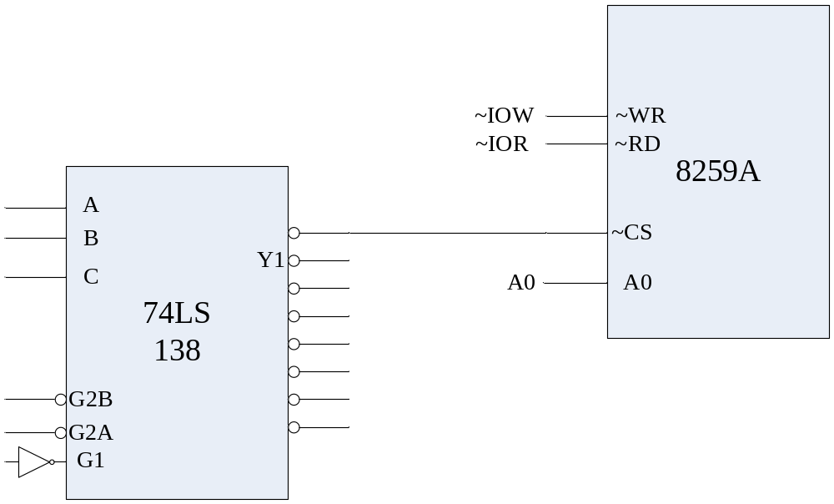
Section 14.4
Use of the 8259 chip in x86 PCs
Interfacing the 8259 to the 8088 in IBM PC
  IBM PC use 1 piece 8259 to extend INTR to 8
  From the function table of 74LS138, we can deduce that the port assign for 8259 is 20H and 21H

Slide 43
Section 14.4
Use of the 8259 chip in x86 PCs
Initialization words of the 8259 in the IBM PC
  ICW1 is set to 00010011(13H): single level only, edge triggering
  In IBM PC interrupt vector table, INT 00~04 are occupied. INT 08H to 0FH are assigned for expansion of hardware interrupts. These interrupts are used by 8259. Thus ICW2=08H;
  ICW3 is not needed
  ICW4 is set 00001001=09H: Normal EOI (EOI needed before IRET), slave buffered mode, not nested.

Slide 44
Section 14.4
Use of the 8259 chip in x86 PCs
The initialization code is:
  MOV AL, 13H ;the ICW1
  OUT 20H, AL
  MOV AL, 8 ;the ICW2
  OUT 21H, AL
  MOV AL, 9 ;the ICW4
  OUT 21H, AL

Slide 45
Section 14.4
Use of the 8259 chip in x86 PCs
Sequence of hardware interrupts with the 8259
When IRn require for a service, 8259 putting a high on INTR;
The processor puts the appropriate signals on S0 S1 S2 = 0 0 0, indicating to the 8288 that an interrupt has been requested.
The 8288 issues the 1st INTA pulse to 8259
8259 locks the IRR, do priority resolution. If its allowed to do response, then ISR is set to inform that IRn is been serviced.
The 8288 issues the 2nd INTA pulse to 8259
The 8259 puts a single interrupt vector byte on the data bus (the interrupt number).
The processor uses this byte to calculate the vector location: location = 4 x interrupt number
The X86 pushes the FR onto stack, clears IF and TF bit. Finally, pushes CS and IP onto stack
Fetch interrupt vector (IP and CS) form vector table, and jump to the interrupt response routine

Slide 46
Appendix
Interrupt and something related
Interrupt: An interrupt is an external event that informs the CPU that a device needs its service.
In IBM PC, IBM use one piece of 8259 to extend interrupt source of 8086 from 1 to 8.
What will happen if more than one interrupt source is requesting service?

Slide 47
Appendix
Interrupt and something related
Interrupt priority and priority based scheduling algorithm: Assign priority levels to each source, and serves the one with the highest priority.
  Static priority based scheduling algorithm: always serves the one with the highest priority.
What if a interrupt request with higher priority comes when a lower request is being serviced?

Slide 48
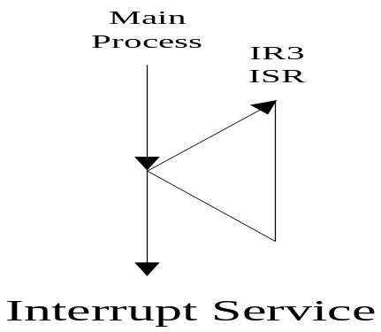
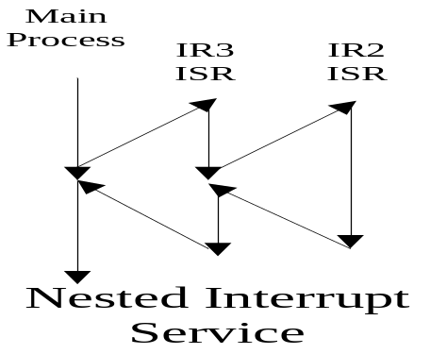
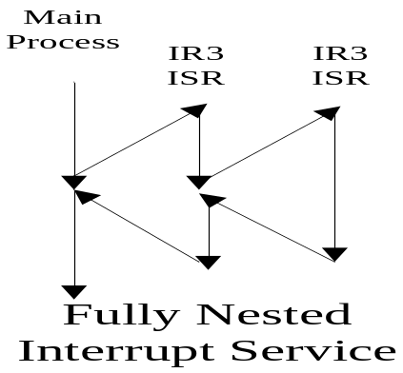
Appendix
Interrupt and something related
Interrupt nesting: The ISR of a lower priority interrupt is interrupted by a higher priority interrupt request.
Fully nested mode:

Slide 49
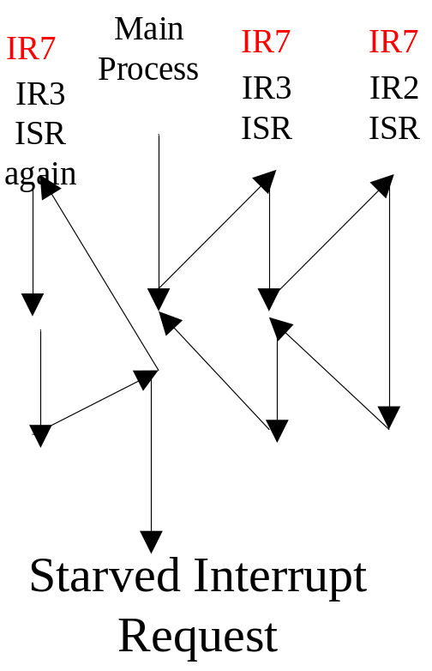
Appendix
Interrupt and something related
Priority based scheduling allows CPU to handle urgent / serious request in time.
However, what if a request with higher priority comes in a very high frequency?
The low priority interrupt request may be starved!

Slide 50
Appendix
Interrupt and something related
Interrupt priority and priority based scheduling algorithm: Assign priority levels to each source, and serves the one with the highest priority.
  Dynamic priority based scheduling algorithm
    Priority rotation:
      R0 R1 R2 R3 R4 R5 R6 R7➔R4R5R6R7 R0R1R2R3
    Selected priority rotation
      R0 R1 R2 R3 R4 R5 R6 R7➔R1R2R3R4R5R6R7R0

